Slide 1
Remarks on Deep Learning (II)
Alberto TONDA, Ph.D. (Senior permanent researcher, DR)
UMR 518 MIA-PS, INRAE, AgroParisTech, Université Paris-Saclay UAR 3611, Institut des Systèmes Complexes de Paris Île-de-France

Slide 2
Outline
Successes
Failures
Reasons for failures and possible solutions
Current trends and perspectives
Beyond Deep Learning…?

Slide 3
Deep Learning achieved incredible results
Since 2012, impressive advancements in image analysis
Human-competitive gameplay on difficult games
Winning against the Go world champion (2016)
Atari challenge approached with Deep Reinforcement Learning
Generative models
Images (Stable Diffusion), videos (Sora from OpenAI)
Text that captures semantics (GPT-4)
Text-to-speech, speech-to-text (elevenlabs.io, now OpenAI)
Prediction of protein folding (AlphaFold 2.0)
Minor revolution in molecular biology

Slide 4
Did Deep Learning solve AI?

Slide 5
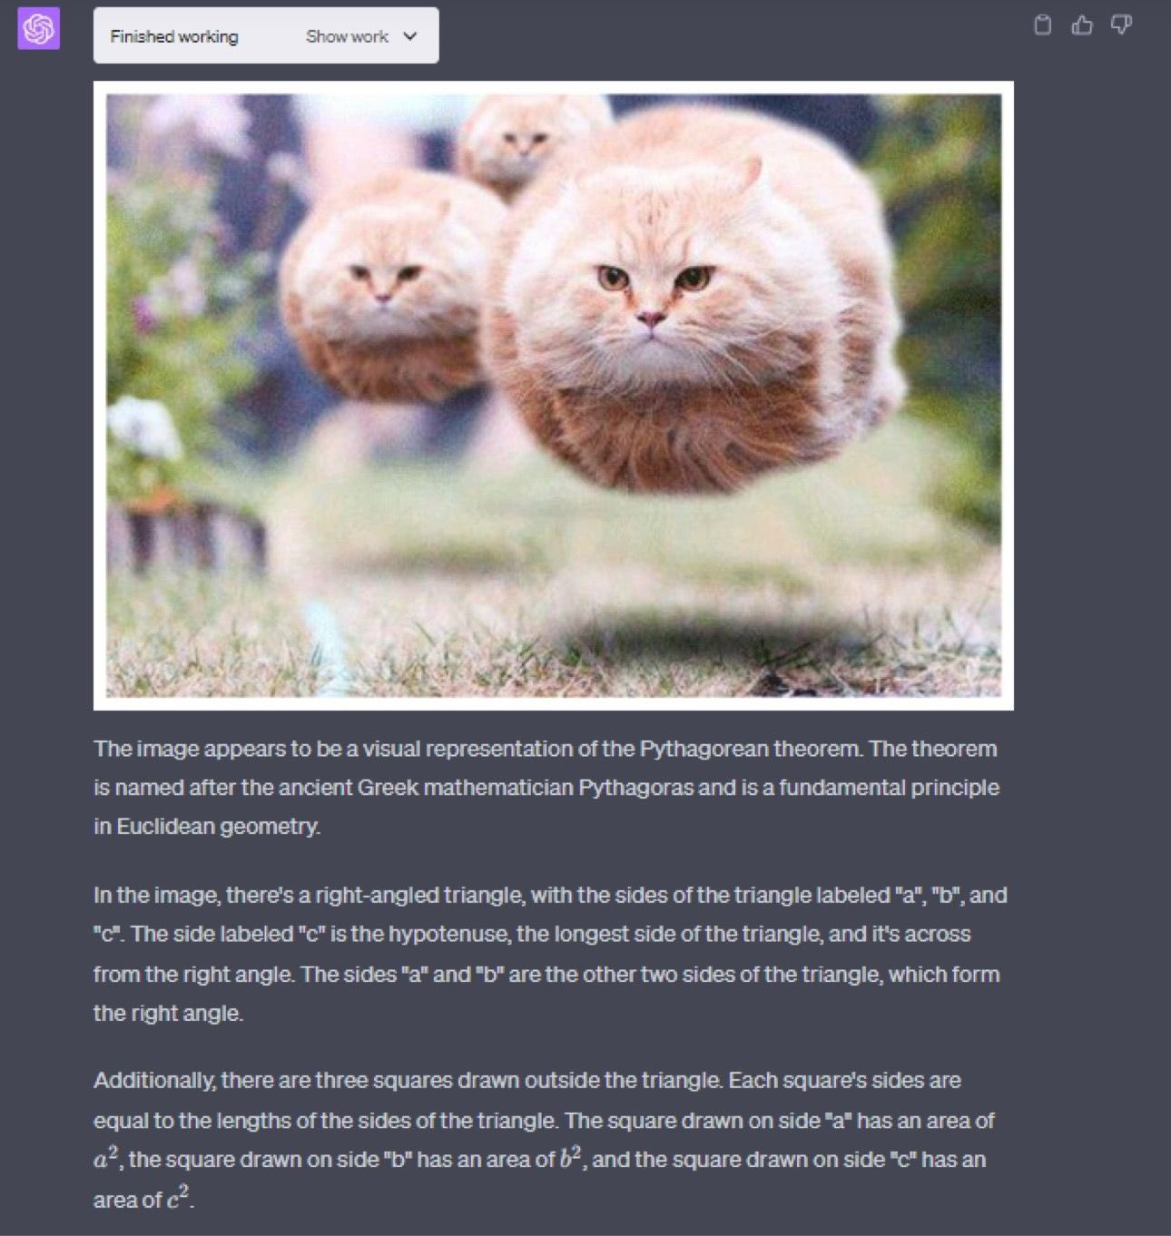
Failures

Slide 6
Failures

Slide 7
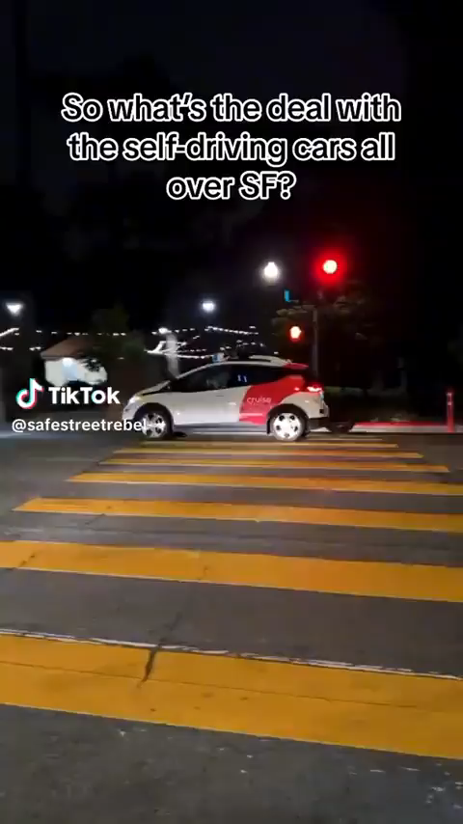
Failures

Slide 8
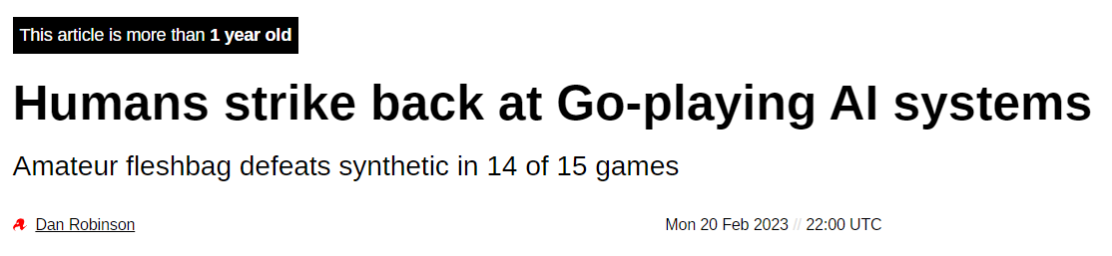
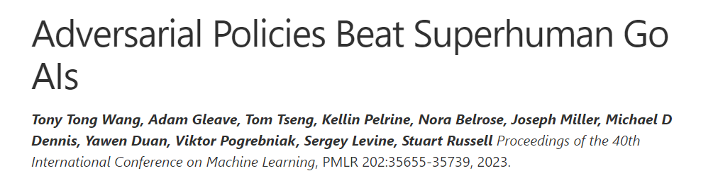
Failures

Slide 9
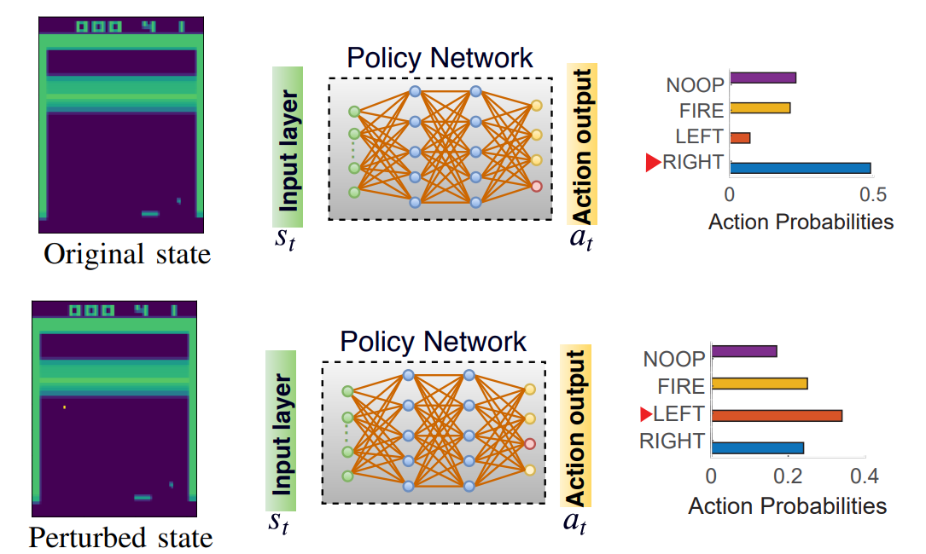
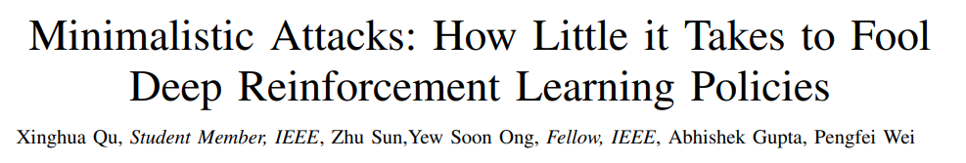
Failures
Changing videogame frame by a few pixels makes DRL fail

Slide 10
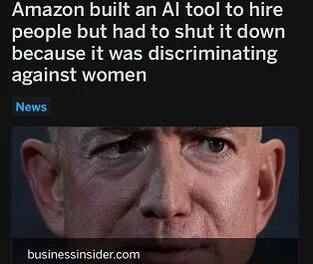
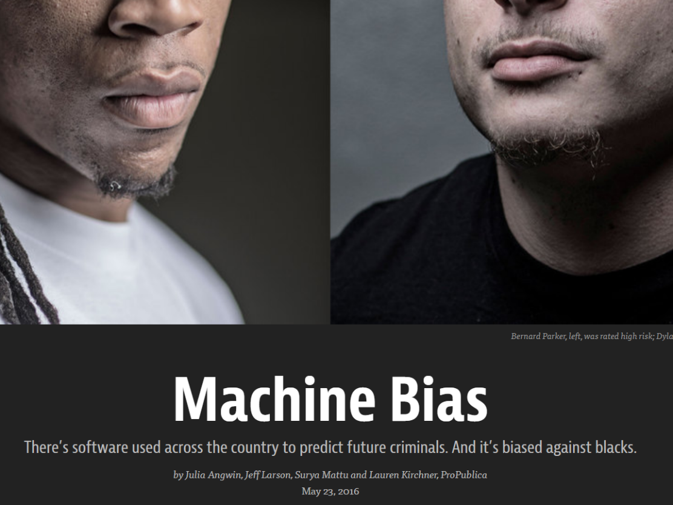
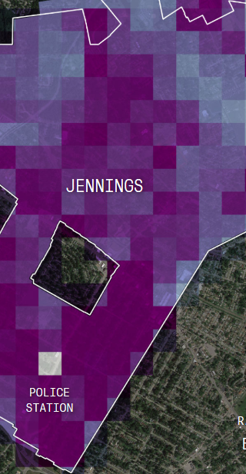
Failures

Slide 11
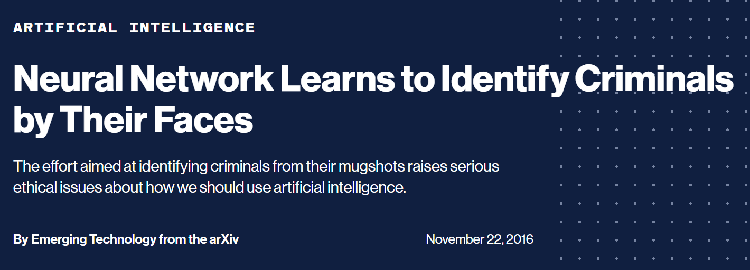
Failures

Slide 12
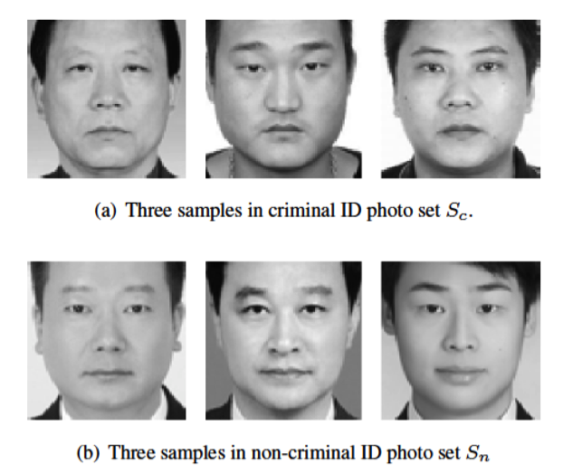
Failures
“Automated Inference on Criminality Using Face Images”, Wu and Zhang, 2016
CNN designed to discriminate criminals/innocents
Technically, the data was properly prepared
Balanced dataset, 50% of each class
Results: 89.5% accuracy!

Slide 13
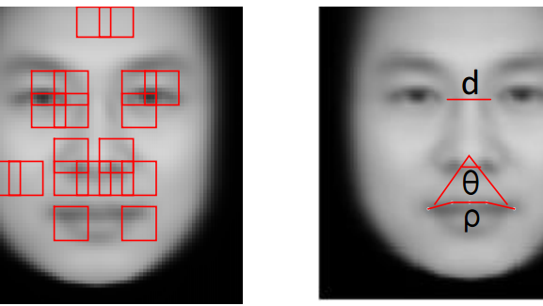
Failures
Analysis of the features extracted/constructed by CNN

Slide 14
Failures
Criminal in mugshots usually do not smile

Slide 15
Reasons for failures
Human factors
Bias in the data; ML reproduces biases
Bad ideas from the start
Fundamental issues with Deep Learning (and ML in general)
Fragility, minimal differences in inputs have huge consequences
Black-box effect, decisions are hard to interpret even if correct
Lack of generalization, issues for new samples if much different

Slide 16
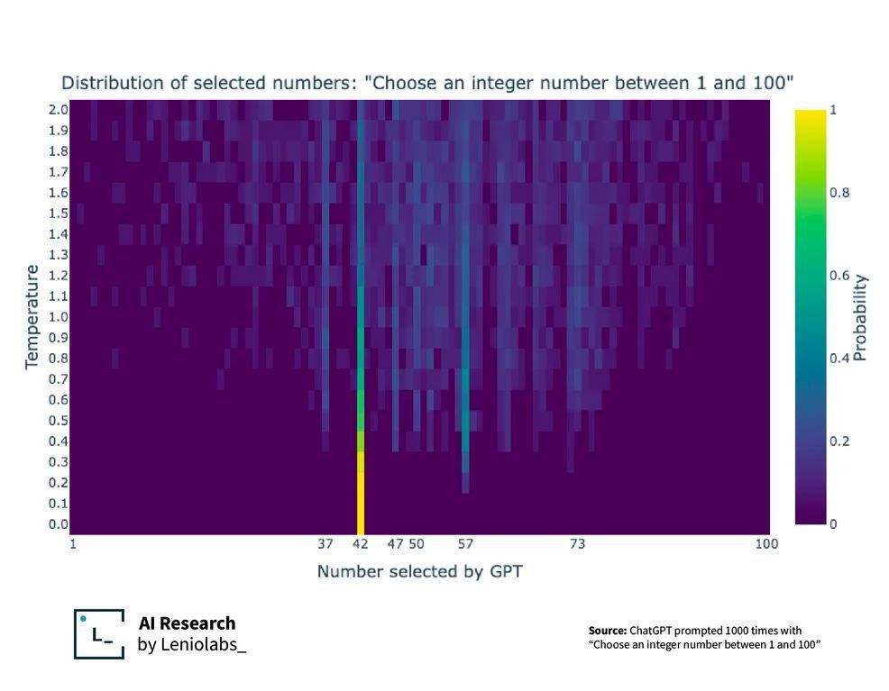
Bias in the data

Slide 17
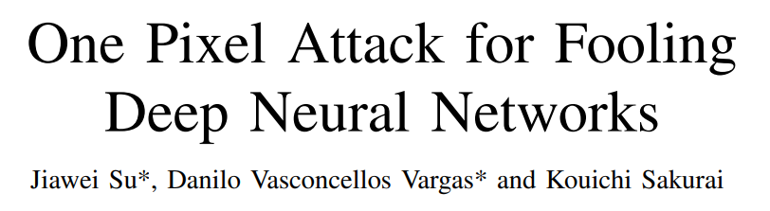
Fragility
Catastrophic, unpredictable failures for some inputs
Even small perturbations on the inputs might cause failure

Slide 18
Possible solutions to fragility
Improve robustness
Generative Adversarial Networks (GANs, or GAML)
Generate samples that make a target ML model fail
Either from scratch, or by perturbing input samples
Add samples to the training set, retrain
Promising idea, thoroughly explored for several years
It does not seem to work
The number of samples that make the system fail is likely infinite
The amount of perturbations needed to fail is too small

Slide 19
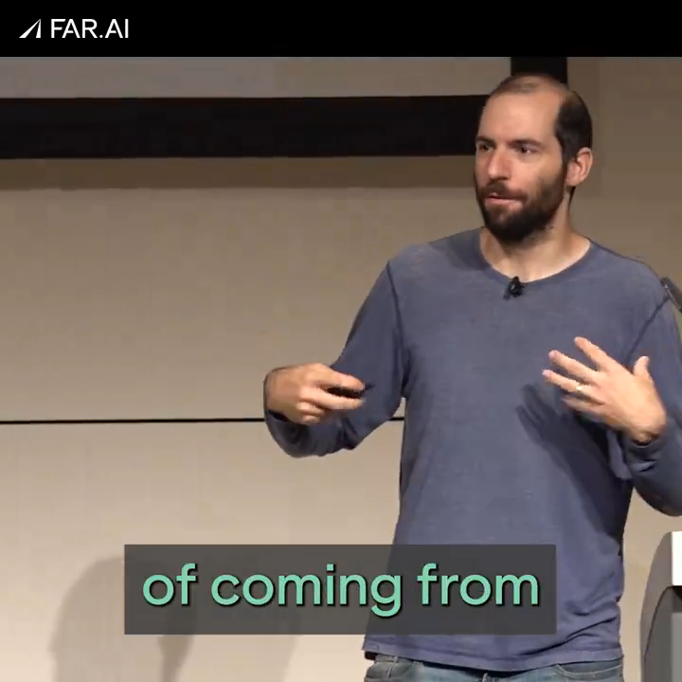
A retrospective on GANs
Alignment workshop (Vienna, July 2024)
Nicholas Carlini, Google DeepMind, ~46k citations

Slide 20
Black-box effect
Mistakes can happen
But an AI system should explain why a choice was made
Understanding is the first step towards improving
All ML makes “non-human” errors, hard to understand

Slide 21
Possible solutions to black-box effect
Improve interpretability and/or explainability
xAI techniques for post-hoc explanations
Models that are interpretable by design (e.g. concept bottlenecks)
Growing interest in causality
ML/DL only detects correlations; assess causal relationships?
You need to impose a causal model

Slide 22
Lack of generalization
Also called “Out-of-Distribution” (OOD) or “Domain Shift”
Input data significantly different from what observed in training
Unpredictable responses, usually wrong
Like fragility, probably caused by overfitting
DL/ML is more “Artificial Intuition” than Intelligence
Seen lots of examples, quickly assess one just by looking at it
But there is no step-by-step reasoning behind decision

Slide 23
Possible solutions to lack of generalization
Neural-symbolic approaches
Include symbolic reasoning in a DL/ML approach
It would also help solve black-box effect and maybe fragility
As previously mentioned, integrating symbolic and DL is difficult
From a certain perspective, symbolic + DL already exists
AlphaGo/AlphaZero is DL + tree search (symbolic)
AlphaFold is DL + classic algorithms (30+ different tools!)
However, it is not enough

Slide 24
Current trends and perspectives
What are people working on, right now? (December 2024)
Hybrid models, *-informed machine learning
Multi-modal systems, mixture-of-experts
Large models on end-user machines
New modules and architectures
Retrieval Augmented Generation (RAG) for LLMs

Slide 25
Hybrid models
A combination of human-designed models + DL/ML
Classic example: Ordinary Differential Equations + DL/ML
Part of an equation is replaced by a ML/DL regressor
Useful to take into account complex relationships
Employed for large ODE systems
Less training samples than replacing everything with DL!

Slide 26
*-informed machine learning
Several tentative names around the same concept
Physics-informed neural networks (PINNs)
Scientific machine learning
Introduce human knowledge on the problem in ML model
Human knowledge does not necessarily appear in data
How to do that?
Add parts to the loss function, to have system respect constraints
Add fake data points to training, created with expert knowledge
Human-designed layers/modules (differentiable programming)

Slide 27
Multi-modal systems, mixture-of-experts
Able to accept inputs of different type: text, images, audio…
Different pathways for each input
Feature extraction, like CNNs and others
Feature fusion, create features from multiple pathways
For a long time, it was a difficult problem
Mixture-of-expert (MoE) systems
Using outputs of different specialized systems to take decision
Each “expert” could use different types of inputs

Slide 28
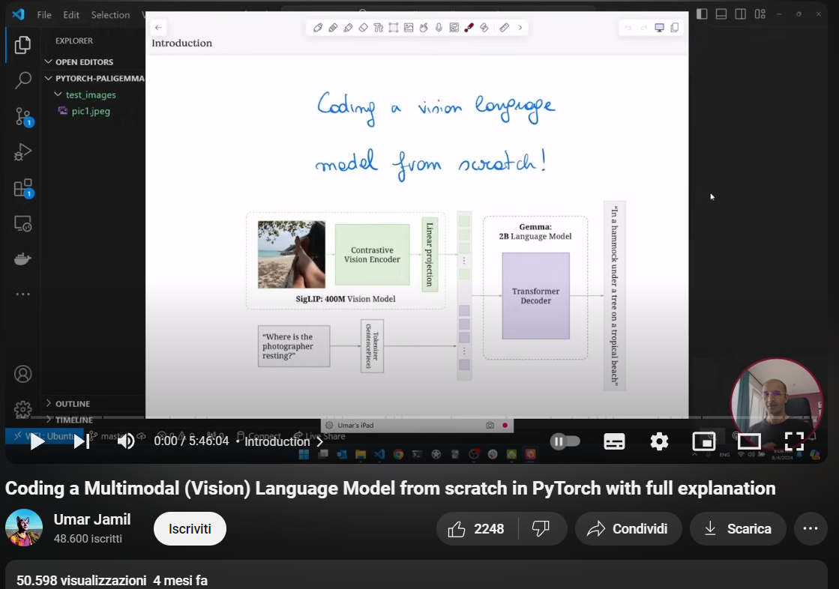
Multi-modal systems, mixture-of-experts
https://youtu.be/vAmKB7iPkWw

Slide 29
Large models on end-user machines
Run large models (10⁹ parameters) locally
Downsizing parameters (from float32 to float16…to int4 !!!)
Loss of performance, but works decently in inference (forward)
Transfer learning on large models
Downsizing of parameters does not really work
Retrain a tiny amount of meaningful parameters
LoRA (Low-Rank Adaptation) seems to work well!
Open-source versions of proprietary models (e.g. GPT-4)
Sharing checkpoints and fine-tuned models

Slide 30
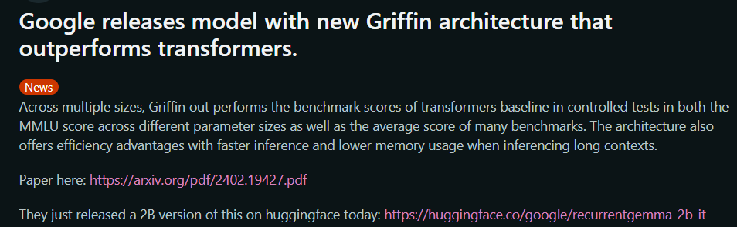
New modules and architectures
Transformers/Attention currently dominate the field
But the race is far from over!
RMKV, large language model with RNN, https://www.rwkv.com/
Mamba, new types of modules for sequences
…
April 9, 2024

Slide 31
New models and architectures
Diffusion/denoising/flow matching neural networks
Used for generation of images (but not only)
Idea: training data is generated by a statistical distribution
Learn how to sample the distribution to generate new data
Using complex tricks from statistics
Approximate target distribution with Gaussian mixtures
Learn complex parameters with gradient descent

Slide 32
Retrieval Augmented Generation for LLMs
Solution (?) to errors in LLM outputs
Start from an established knowledge base
Search in the knowledge base, find documents from tags
Give documents in input to LLM
LLM generates summary based on documents

Slide 33
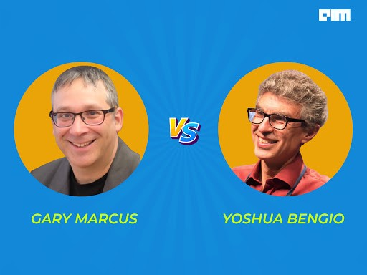
Beyond Deep Learning…?
Two different world views
All problems can be solved with more/better data and by increasing the size of the models
In order to overcome current DL limitations, we need radically different architectures and taking into account symbols

Slide 34
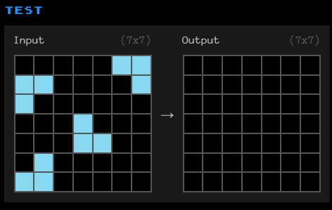
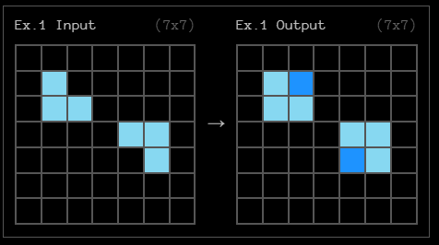
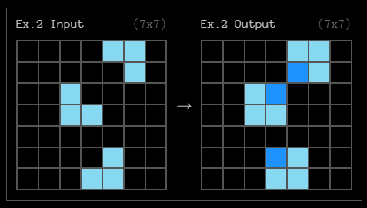
Beyond Deep Learning
?

Slide 35
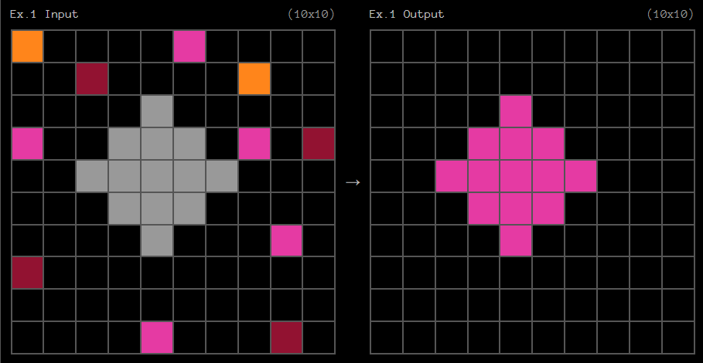
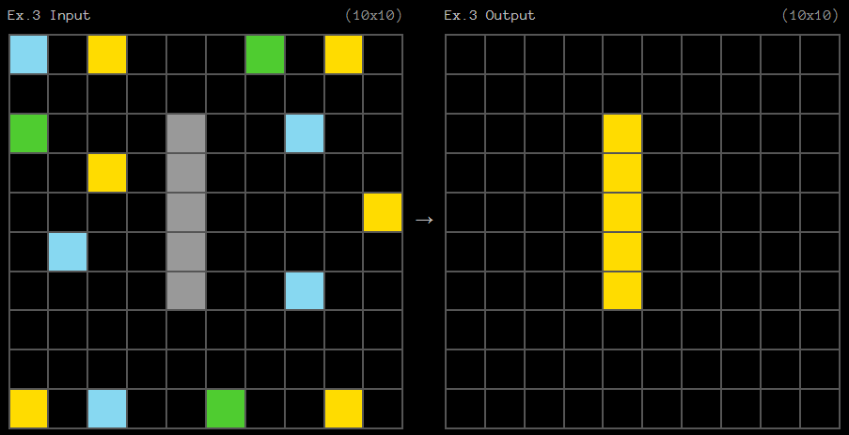
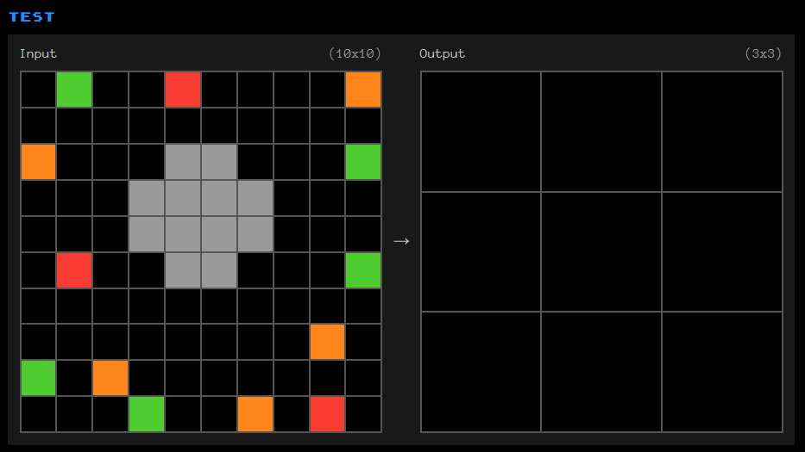
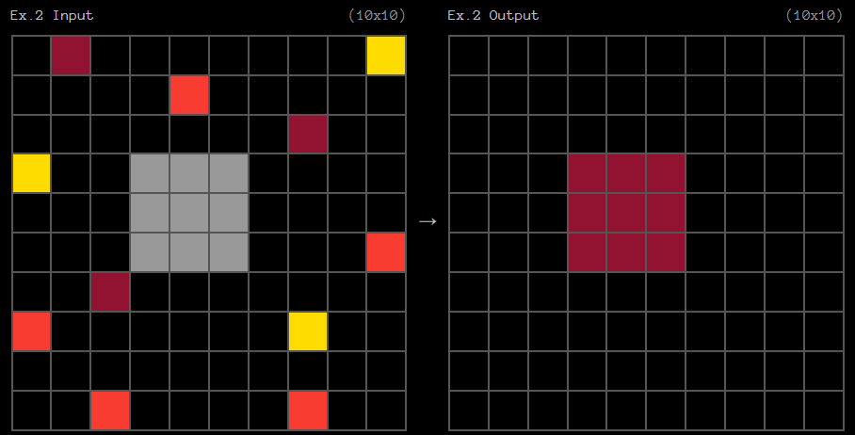
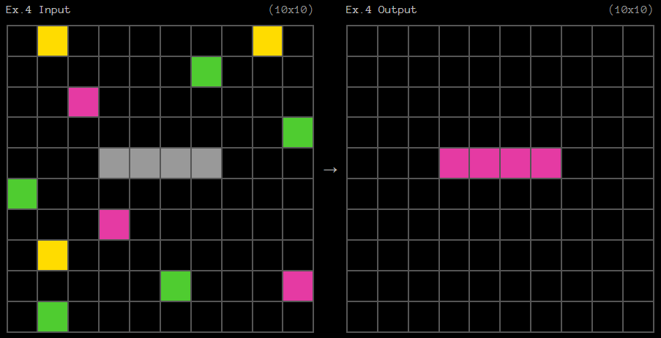
Beyond Deep Learning
?
?

Slide 36
Beyond Deep Learning…?
DL/ML works well, but it is not how humans learn
Humans can learn from few samples and generalize well
Can research on human cognition help AI?
“On the measure of intelligence”, F. Chollet (2019)
Intelligence: ability to quickly and effectively learn new tasks
Abstraction and Reasoning Corpus (ARC) Prize, 2024
Thousands of competitors, 1M$ prize (more or less)
Best result: 55% (vs human ~90%), https://arcprize.org/

Slide 37
Beyond Deep Learning…?
Out of the competition, a new idea!
Test-time tuning
A little bit like fine-tuning, but at test time
Slight modification of parameters based on test examples
Improves generalization to difficult cases
Requires some data augmentation

Slide 38
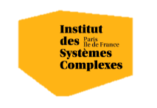

Questions?
Bibliography - ARC Prize Report, https://arcprize.org/2024-results - Bergstrom C. & West J. Calling Bullshit: Data Reasoning in a Digital World, https://www.callingbullshit.org/ - Chollet, F. (2019). On the measure of intelligence. arXiv preprint arXiv:1911.01547. - Cuomo, S. et al. (2022). Scientific machine learning through physics–informed neural networks: Where we are and what’s next. Journal of Scientific Computing, 92(3), 88. - De, S. et al. (2024). Griffin: Mixing Gated Linear Recurrences with Local Attention for Efficient Language Models. arXiv preprint arXiv:2402.19427. - Marcus, G. (2020). The next decade in AI: four steps towards robust artificial intelligence. arXiv preprint arXiv:2002.06177. - Gu, A., & Dao, T. (2023). Mamba: Linear-time sequence modeling with selective state spaces. arXiv preprint arXiv:2312.00752. - Hu, E. J. et al. (2021). LoRA: Low-rank adaptation of large language models. arXiv preprint arXiv:2106.09685. - Qu, X. et al. (2020). Minimalistic attacks: How little it takes to fool deep reinforcement learning policies. IEEE Transactions on Cognitive and Developmental Systems, 13(4), 806-817. - Su, J., Vargas, D. V., & Sakurai, K. (2019). One pixel attack for fooling deep neural networks. IEEE Transactions on Evolutionary Computation, 23(5), 828-841. - Wang, T. T. et al. (2023, July). Adversarial policies beat superhuman go AIs. In International Conference on Machine Learning (pp. 35655-35739). PMLR. - Wu, X., & Zhang, X. (2016). Automated inference on criminality using face images. arXiv preprint arXiv:1611.04135, 4038-4052. - Wu, X., & Zhang, X. (2016). Responses to critiques on machine learning of criminality perceptions (Addendum of arXiv: 1611.04135). arXiv preprint arXiv:1611.04135.
Images and videos: unless otherwise stated, I stole them from the Internet. I hope they are not copyrighted, or that their use falls under the Fair Use clause, and if not, I am sorry. Please don’t sue me.

